Slide 1
Unit 3
Data analysis, Interpretation and Reporting

Slide 2
Sampling
Sampling is a process in statistical analysis where researchers take a predetermined number of observations from a larger population.
Sampling allows researchers to conduct studies about a large group by using a small portion of the population.
The method of sampling depends on the type of analysis being performed.
Sampling is commonly done in statistics, psychology, and the financial industry.

Slide 3
Sampling is an essential part of any research project.
The right sampling method can make or break the validity of your research, and it’s essential to choose the right method for your specific question.

Slide 4
Sampling is a technique of selecting individual members or a subset of the population to make statistical inferences from them and estimate the characteristics of the whole population.
Different sampling methods are widely used by researchers in market research so that they do not need to research the entire population to collect actionable insights.
It is also a time-convenient and cost-effective method and hence forms the basis of any research design.
Sampling techniques can be used in research survey software for optimum derivation.

Slide 5
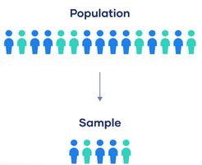
Population vs. sample
The population is the entire group that you want to draw conclusions about.
The sample is the specific group of individuals that you will collect data from.

Slide 6
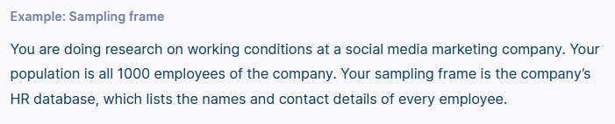
Sampling frame
The sampling frame is the actual list of individuals that the sample will be drawn from. Ideally, it should include the entire target population (and nobody who is not part of that population).

Slide 7
Sample size
The number of individuals you should include in your sample depends on various factors, including the size and variability of the population and your research design.
There are different sample size calculators and formulas depending on what you want to achieve with statistical analysis.

Slide 8
Sampling Bias
Sampling bias occurs when some members of a population are systematically more likely to be selected in a sample than others.
Sampling bias or a biased sample in research occurs when members of the intended population are selected incorrectly – either because they have a lower or a higher chance of being selected.
Causes and types of sampling bias

Slide 9
Types of Sampling
There are two primary types of sampling methods that you can use in your research:
Probability sampling involves random selection, allowing you to make strong statistical inferences about the whole group.
Non-probability sampling involves non-random selection based on convenience or other criteria, allowing you to easily collect data.

Slide 10
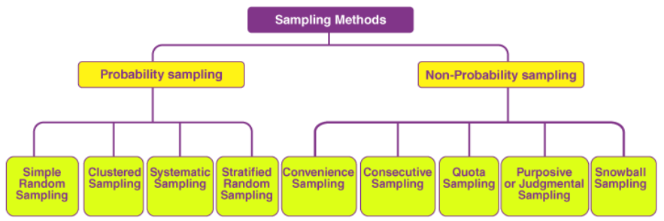

Slide 11
Probability sampling

Slide 12
Probability sampling
Probability sampling is a sampling technique where a researcher selects a few criteria and chooses members of a population randomly. All the members have an equal opportunity to participate in the sample with this selection parameter.
The probability sampling method utilizes some form of random selection.
In this method, all the eligible individuals have a chance of selecting the sample from the whole sample space.
This method is more time consuming and expensive than the non-probability sampling method.
The benefit of using probability sampling is that it guarantees the sample that should be the representative of the population.

Slide 13
Probability Sampling Types
Simple Random Sampling
Systematic Sampling
Stratified Sampling
Clustered Sampling

Slide 14
Simple Random Sampling
One of the best probability sampling techniques that helps in saving time and resources is the Simple Random Sampling method.
In simple random sampling technique, every item in the population has an equal and likely chance of being selected in the sample.
It is a reliable method of obtaining information where every single member of a population is chosen randomly, merely by chance. Each individual has the same probability of being chosen to be a part of a sample.
Since the item selection entirely depends on the chance, this method is known as “Method of chance Selection”.
As the sample size is large, and the item is chosen randomly, it is known as “Representative Sampling”.

Slide 15
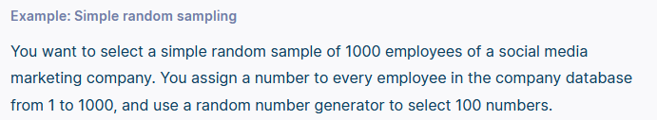

Slide 16
2. Systematic Sampling
Researchers use the systematic sampling method to choose the sample members of a population at regular intervals.
It requires selecting a starting point for the sample and sample size determination that can be repeated at regular intervals.
This type of sampling method has a predefined range; hence, this sampling technique is the least time-consuming.
Systematic sampling is similar to simple random sampling, but it is usually slightly easier to conduct.
Every member of the population is listed with a number, but instead of randomly generating numbers, individuals are chosen at regular intervals.

Slide 17
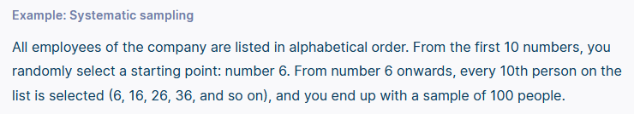

Slide 18
3. Stratified Sampling
Stratified random sampling is a method in which the researcher divides the population into smaller groups that don’t overlap but represent the entire population.
It allows you draw more precise conclusions by ensuring that every subgroup is properly represented in the sample.
To use this sampling method, you divide the population into subgroups (called strata) based on the relevant characteristic (e.g., gender identity, age range, income bracket, job role).
Based on the overall proportions of the population, you calculate how many people should be sampled from each subgroup. Then you use random or systematic sampling to select a sample from each subgroup.

Slide 19
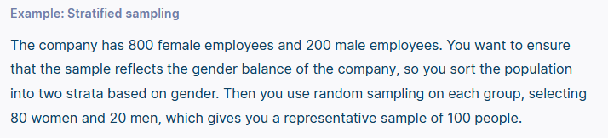
Another example,
There are three bags (A, B and C), each with different balls. Bag A has 50 balls, bag B has 100 balls, and bag C has 200 balls. We have to choose a sample of balls from each bag proportionally. Suppose 5 balls from bag A, 10 balls from bag B and 20 balls from bag C.

Slide 20
Clustered Sampling
Cluster sampling is a method where the researchers divide the entire population into sections or clusters representing a population.
In the clustered sampling method, the cluster or group of people are formed from the population set.
The group has similar significatory characteristics. Also, they have an equal chance of being a part of the sample.
Instead of sampling individuals from each subgroup, you randomly select entire subgroups. This method uses simple random sampling for the cluster of population.
If it is practically possible, you might include every individual from each sampled cluster. If the clusters themselves are large, you can also sample individuals from within each cluster using one of the techniques above. This is called multistage sampling.
This method is good for dealing with large and dispersed populations, but there is more risk of error in the sample, as there could be substantial differences between clusters.
It’s difficult to guarantee that the sampled clusters are really representative of the whole population.

Slide 21
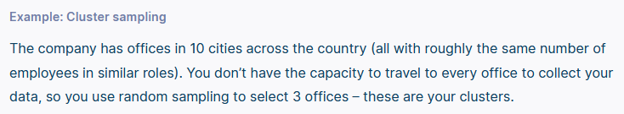

Slide 22
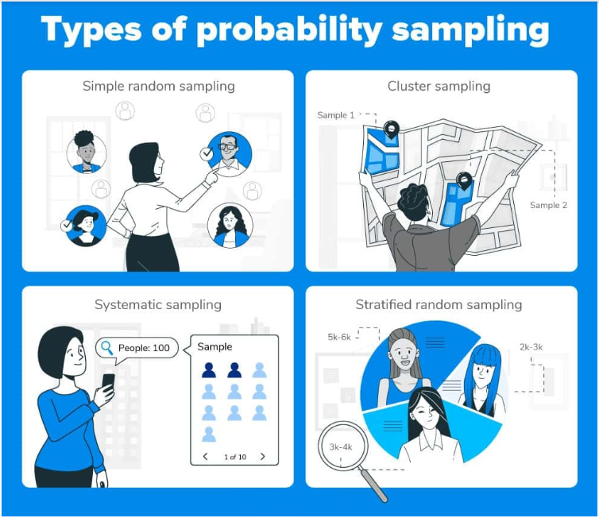

Slide 23
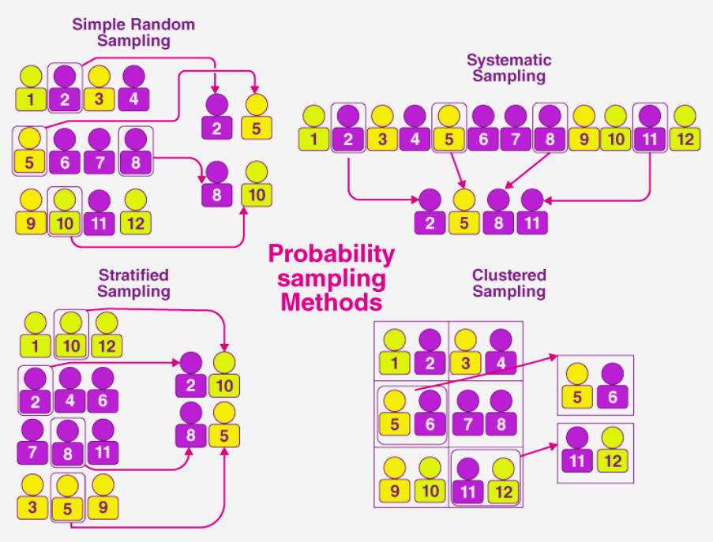

Slide 24
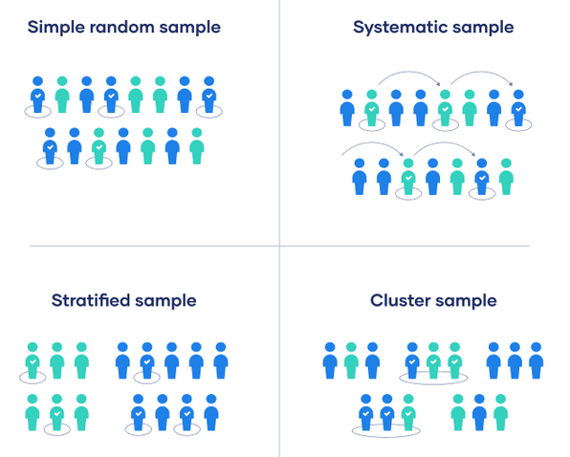

Slide 25
Uses of probability sampling
Reduce Sample Bias: Using the probability sampling method, the research bias in the sample derived from a population is negligible to non-existent. The sample selection mainly depicts the researcher’s understanding and inference. Probability sampling leads to higher-quality data collection as the sample appropriately represents the population.
Diverse Population: When the population is vast and diverse, it is essential to have adequate representation so that the data is not skewed toward one demographic.
Create an Accurate Sample: Probability sampling helps the researchers plan and create an accurate sample. This helps to obtain well-defined data.

Slide 26
Non-Probability Sampling

Slide 27
Non-probability sampling
The non-probability sampling method is a technique in which the researcher selects the sample based on subjective judgment rather than the random selection.
This sampling method is not a fixed or predefined selection process.
This makes it difficult for all population elements to have equal opportunities to be included in a sample.
In this method, not all the members of the population have a chance to participate in the study.

Slide 28
Non-Probability Sampling Types
Convenience Sampling
Quota Sampling
Purposive or Judgmental Sampling
Snowball Sampling

Slide 29
Convenience Sampling (also called haphazard, grab, opportunity, or accidental sampling)
In a convenience sampling method, the samples are selected from the population directly because they are conveniently available for the researcher.
The samples are easy to select, and the researcher did not choose the sample that outlines the entire population.
A convenience sample simply includes the individuals who happen to be most accessible to the researcher.
This is an easy and inexpensive way to gather initial data, but there is no way to tell if the sample is representative of the population, so it can’t produce generalizable results.
Convenience samples are at risk for both sampling bias and selection bias.

Slide 30
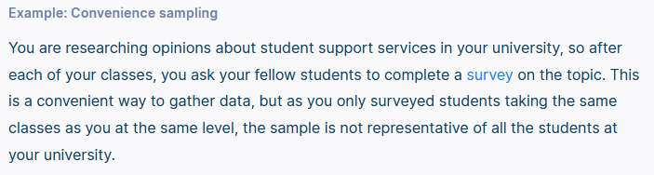
Another Example:
In researching customer support services in a particular region, we ask your few customers to complete a survey on the products after the purchase. This is a convenient way to collect data. Still, as we only surveyed customers taking the same product. At the same time, the sample is not representative of all the customers in that area.

Slide 31
Convenience sampling also has two subtypes:
Consecutive sampling (also known as total enumerative sampling)
Self-selection (also known as volunteer sampling)

Slide 32
Consecutive Sampling
Consecutive sampling is similar to convenience sampling with a slight variation.
The researcher picks a single person or a group of people for sampling.
Then the researcher researches for a period of time to analyze the result and move to another group if needed.
Samples are chosen based on availability and each result is analysed before you move onto the next sample or subject.
This method is an effective way to obtain results because it allows the researcher to modify and adjust their results.

Slide 33
Voluntary response sampling
Similar to a convenience sample, a voluntary response sample is mainly based on ease of access. Instead of the researcher choosing participants and directly contacting them, people volunteer themselves (e.g. by responding to a public online survey).
Voluntary response samples are always at least somewhat biased, as some people will inherently be more likely to volunteer than others, leading to self-selection bias.
This requires less work contacting people, as volunteers sign up and opt-in to be part of the research if they meet your desired criteria.
The insights gained will likely be based on strongly held opinions that these volunteers want to share.

Slide 34
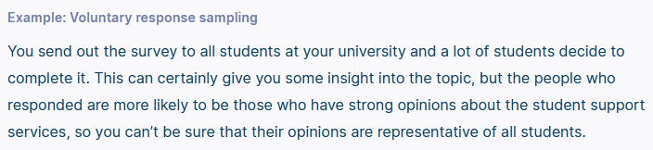
Another example
Medical research candidates that opt into medical studies because they fit the criteria of the research study and want to be involved for health reasons.

Slide 35
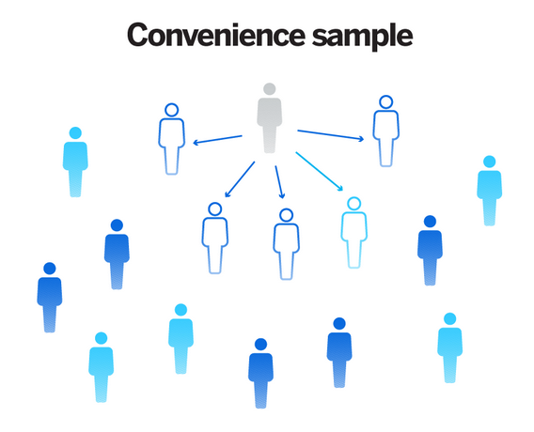
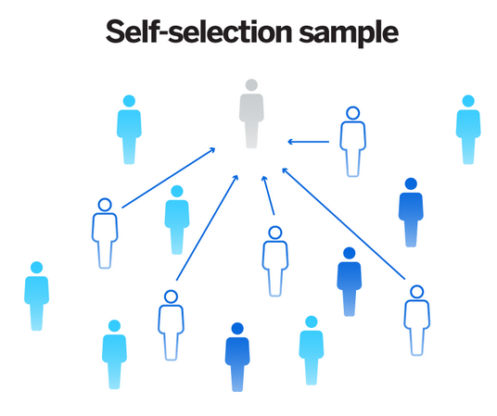

Slide 36
2. Quota Sampling
Quota sampling relies on the non-random selection of a predetermined number or proportion of units. This is called a quota.
You first divide the population into mutually exclusive subgroups (called strata) and then recruit sample units until you reach your quota.
These units share specific characteristics, determined by you prior to forming your strata.
In the quota sampling method, the researcher forms a sample that involves the individuals to represent the population based on specific traits or qualities.
The researcher chooses the sample subsets that bring the useful collection of data that generalizes the entire population.
The aim of quota sampling is to control what or who makes up your sample.

Slide 37
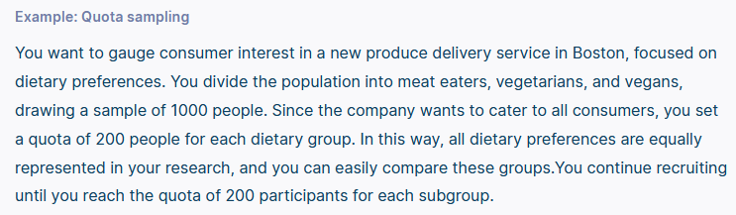
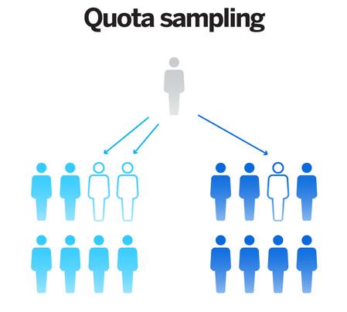

Slide 38
3. Purposive or Judgmental Sampling
In purposive sampling, the samples are selected only based on the researcher’s knowledge.
As their knowledge is instrumental in creating the samples, there are the chances of obtaining highly accurate answers with a minimum marginal error. It is also known as judgmental sampling or authoritative sampling.
This type of sampling, involves the researcher using their expertise to select a sample that is most useful to the purposes of the research.
It is often used in qualitative research, where the researcher wants to gain detailed knowledge about a specific phenomenon rather than make statistical inferences, or where the population is very small and specific.
An effective purposive sample must have clear criteria and rationale for inclusion.
Always make sure to describe your inclusion and exclusion criteria and beware of observer bias affecting your arguments.

Slide 39

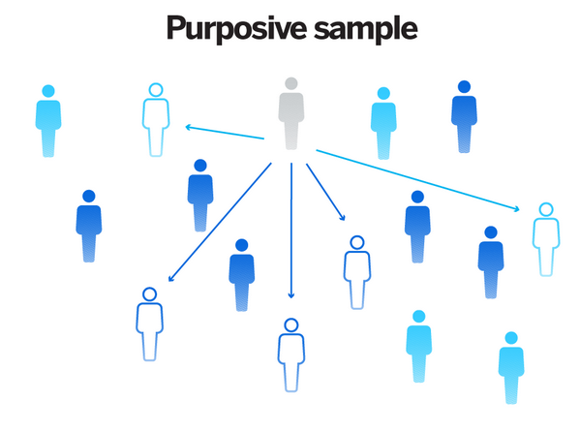

Slide 40
4. Snowball Sampling
Snowball sampling is also known as a chain-referral sampling technique.
In this method, the samples have traits that are difficult to find. So, each identified member of a population is asked to find the other sampling units. Those sampling units also belong to the same targeted population.
(If the population is hard to access, snowball sampling can be used to recruit participants via other participants.)
The number of people you have access to “snowballs” as you get in contact with more people.
The downside here is also representativeness, as you have no way of knowing how representative your sample is due to the reliance on participants recruiting others. This can lead to sampling bias.

Slide 41
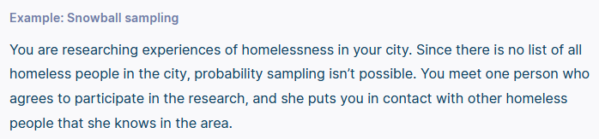
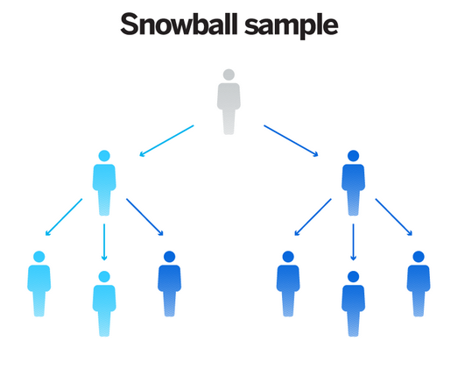

Slide 42
Uses of non-probability sampling
Create a hypothesis: Researchers use the non-probability sampling method to create an assumption when limited to no prior information is available. This method helps with the immediate return of data and builds a base for further research.
Exploratory research: Researchers use this sampling technique widely when conducting qualitative research, pilot studies, or exploratory research.
Budget and time constraints: The non-probability method when there are budget and time constraints, and some preliminary data must be collected. Since the survey design is not rigid, it is easier to pick respondents randomly and have them take the survey or questionnaire.

Slide 43
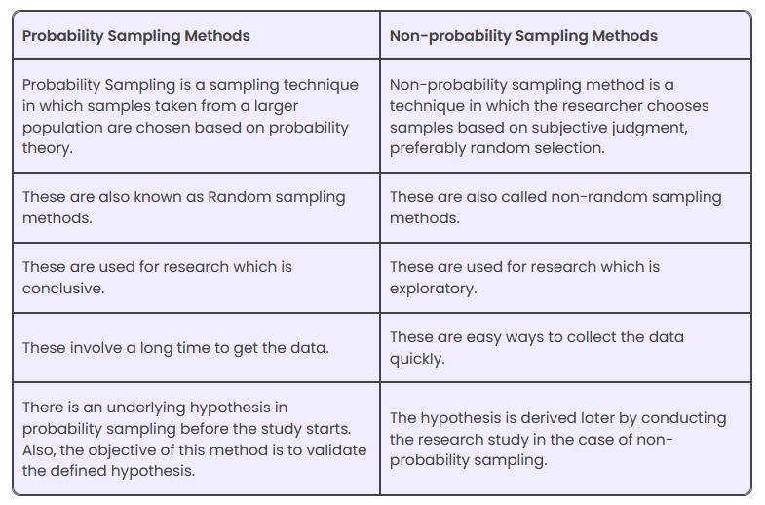

Slide 44
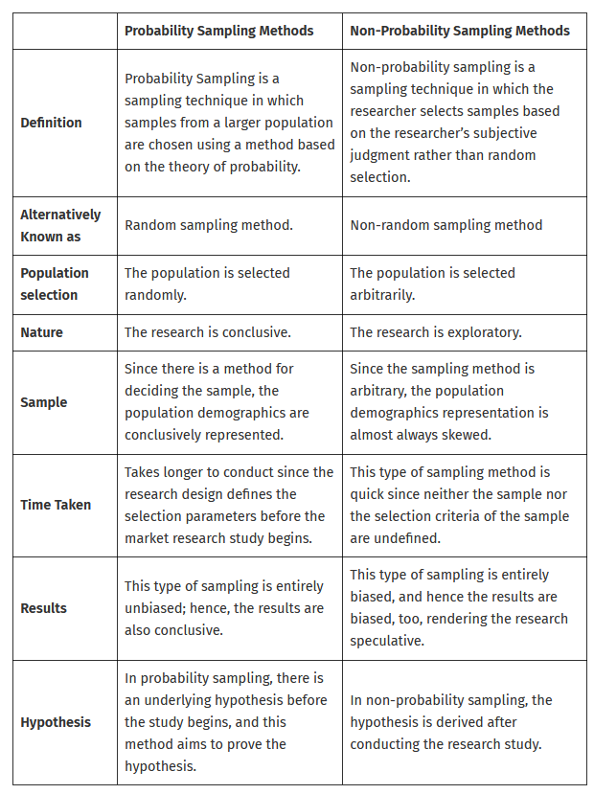

Slide 45
Sampling Error
Sampling error can be measured in different ways, but in reality, the error obtained is almost always an estimate of the actual error rather than the absolute measure of the error.
To calculate any true population, first, we have to calculate the sample value.
Let us take the true value of the population as “k”. But we don’t know the real value of k. So we calculated some sample value of k.
After that, when the original value of k is found, it has some difference compared with the true value. The difference between these two values is called error.
It can be calculated from the population and sample. Normally sampling error means the difference between the sample value and the population value.

Slide 46
Another Definition
Sampling error is defined as the amount of inaccuracy in estimating some value, which occurs due to considering a small section of the population, called the sample, instead of the whole population. It is also called an error.
Sample surveys take into account the study of a tiny segment of a population, so, there is always a particular amount of inaccuracy in the information obtained.
This inaccuracy can be defined as error variance or sampling error.

Slide 47
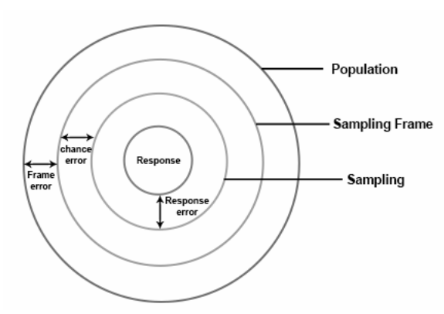
Sampling Error = (Response Error) + (Frame Error) + (Chance Error)

Slide 48
Sampling Error Formula
The measure of the sampling error can be calculated for particular sample size and design. This measure is termed as the correctness of the sampling plan.
Sampling error is also due to the concept called sampling bias. This error is considered a systematic error.
If N is the sample size and SE is the sampling error, then
Sampling Error, S. E = (1/√ N) 100

Slide 49
Example of sampling error
Let’s say a political party conducts a survey to find out how well-liked their candidate is before a major election. Instead of picking a random sample of the whole population to survey, they only ask their own members.
The sample would be skewed since party members may have extremely different opinions and tastes from the rest of the population. Party members may care more about their candidate’s ideals or be more loyal to them. This may cause the survey to suggest more support than the general population has.
Suppose the survey results are used to make campaign decisions, such as where to allocate money or which issues to prioritize. In that case, they may not accurately reflect the candidate’s support among the people. This could result in a poor campaign plan, affecting their election chances.
To avoid these kinds of sampling errors, it is essential to use a sampling method that is representative of the population being studied, such as random sampling or stratified random sampling, and to make sure that the sample size is big enough to give accurate results.

Slide 50
Controlling your sampling error
Statistical theories help researchers measure the probability of sampling errors in sample size and population.
The size of the sample considered from the population primarily determines the size of the sampling error. Larger sample sizes tend to encounter a lower rate of errors.
Researchers use a metric known as the margin of error to understand and evaluate the margin of error. Usually, a confidence level of 95% is considered to be the desired confidence level.

Slide 51
How to Reduce Sampling Error?
There are two methods by which this sampling error can be reduced. The methods are
Increasing sample size
Stratification

Slide 52
Increasing Sample Size
From a population, we can select any sample of any size.
The size depends on the experiment and the situation. If the size of the sample increases, the chance of occurrence of the sampling error will be less. There will be no error if the sample size and the population size coincide.
Hence, sampling error is in inverse proportion to the sample size.

Slide 53
Stratification
If all the population units are homogeneous or the population has the same characteristic feature, it’s very easy to get a sample.
The sample can be taken as a representative of the entire population. But if the population is not homogeneous (i.e population with the different characteristic features); it is impossible to get a perfect sample.
In such conditions, to get a better representative, the sample design is altered. The population is classified into different groups called strata, that contain similar units.
From each of these strata, a sub-sample is selected in a random manner. Thus, all the groups are defined in the sample, the sampling error is reduced.
Hence, the sub-sample size from each stratum is in proportion with the stratum size.

Slide 54
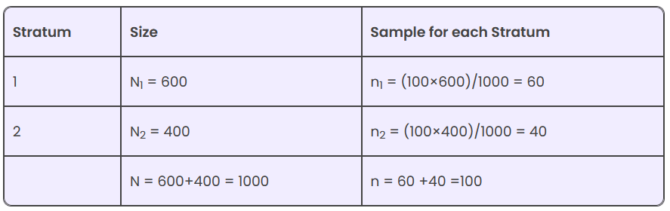
Assume that the size of the population is 1000, out of which 600 are men, and 400 are women, select 100 members.

Slide 55
Sampling error vs. Sampling bias
Sampling in statistics means choosing the research group. Sampling error and sampling bias affect sample accuracy and representativeness in statistics.
Sampling error occurs because a sample is a subset of the population and may not precisely represent it.
Instead, sampling bias occurs when the sample is not representative of the population.
This may happen if the method used to choose the sample favors or excludes particular sorts of people, resulting in an overrepresentation or underrepresentation of particular groups.

Slide 56
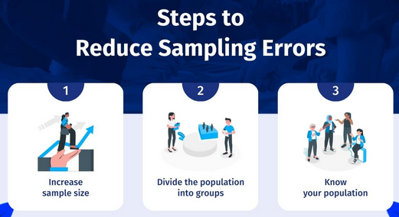

Slide 57
Increase sample size A larger sample size is more accurate because the study gets closer to the actual population size.
Divide the population into groups Test groups according to their size in the population instead of a random sample. For example, if people of a specific demographic make up 20% of the population, make sure that your study is made up of this variable to reduce sampling bias.
Know your population Study your population and understand its demographic mix. Know what demographics use your product and service and ensure you only target the sample that matters.

Slide 58
Surveys can have sampling and non-sampling errors. Survey findings can be affected by sampling and non-sampling mistakes.
Sampling error
Sampling error arises when a survey sample does not accurately represent the population being researched due to random sampling. Sampling and non-response bias, measurement error, and sampling variability can cause this.
Sampling error can be reduced by utilizing appropriate sampling procedures and increasing the sample size.
Non-sampling error
Non-sampling error includes all survey errors other than sampling errors. This includes questionnaire design, coding, data input, data collection, processing, and analysis errors. Improper interviewer training, insufficient or inaccurate data, or data analysis or reporting errors can create non-sampling errors.
Non-sampling error can be decreased by applying quality control measures and ensuring that all components of the survey process are properly designed, implemented, and monitored.

Slide 59
Measures of central tendency and variation

Slide 60
central tendency
The central tendency is stated as the statistical measure that represents the single value of the entire distribution or a dataset. It aims to provide an accurate description of the entire data in the distribution.
In statistics, the central tendency is the descriptive summary of a data set. Through the single value from the dataset, it reflects the centre of the data distribution.
Moreover, it does not provide information regarding individual data from the dataset, where it gives a summary of the dataset.
Generally, the central tendency of a dataset can be defined using some of the measures in statistics.

Slide 61
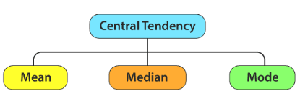
Measures of Central Tendency
The central tendency of the dataset can be found out using the three important measures namely mean, median and mode.

Slide 62
Mean
The mean represents the average value of the dataset. It can be calculated as the sum of all the values in the dataset divided by the number of values. In general, it is considered as the arithmetic mean.
Mean for sample is denoted by symbol ‘M or x̅ (‘x-bar’)’ and mean for population is denoted by ‘µ’ (mu).
Some other measures of mean used to find the central tendency are as follows:
Geometric Mean
Harmonic Mean
Weighted Mean

Slide 63
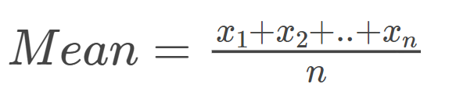
It is observed that if all the values in the dataset are the same, then all geometric, arithmetic and harmonic mean values are the same.
If there is variability in the data, then the mean value differs.
The formula to calculate the mean value is given by:

Slide 64
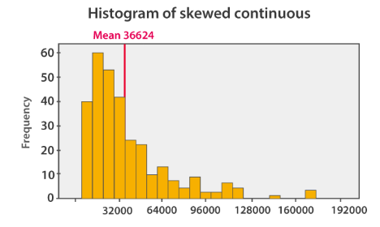
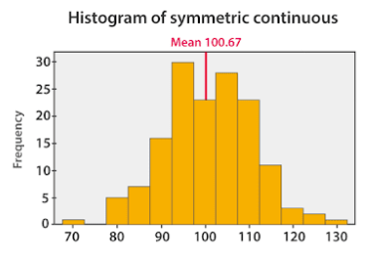
The histogram given below shows that the mean value of symmetric continuous data and the skewed continuous data.

Slide 65
In symmetric data distribution, the mean value is located accurately at the centre.
But in the skewed continuous data distribution, the extreme values in the extended tail pull the mean value away from the centre.
So it is recommended that the mean can be used for the symmetric distributions.

Slide 66
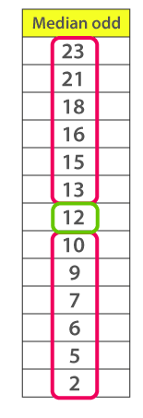
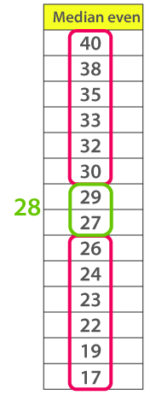
Median
Median is the middle value of the dataset in which the dataset is arranged in the ascending order or in descending order.
When the dataset contains an even number of values, then the median value of the dataset can be found by taking the mean of the middle two values.
Median is the middle score in an ordered distribution.
The symbol for median is ‘M_{d}’.

Slide 67
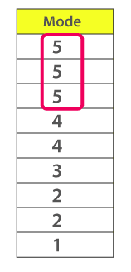
Mode
The mode represents the frequently occurring value in the dataset. Sometimes the dataset may contain multiple modes and in some cases, it does not contain any mode at all.
Mode is denoted by symbol ‘M_{o}’.

Slide 68
Based on the properties of the data, the measures of central tendency are selected.
If you have a symmetrical distribution of continuous data, all the three measures of central tendency hold good. But most of the times, the analyst uses the mean because it involves all the values in the distribution or dataset.
If you have skewed distribution, the best measure of finding the central tendency is the median.
If you have the original data, then both the median and mode are the best choice of measuring the central tendency.
If you have categorical data, the mode is the best choice to find the central tendency.

Slide 69
The main functions of measures of central tendency are as follows:
They provide a summary figure with the help of which the central location of the whole data can be explained. When we compute an average of a certain group we get an idea about the whole data.
Large amount of data can be easily reduced to a single figure. Mean, median and mode can be computed for a large data and a single figure can be derived.
When mean is computed for a certain sample, it will help gauge the population mean.
The results obtained from computing measures of central tendency will help in making certain decisions. This holds true not only to decisions with regard to research but could have applications in varied areas like policy making, marketing and sales and so on.
Comparison can be carried out based on single figures computed with the help of measures of central tendency. For example, with regard to performance of students in mathematics test, the mean marks obtained by girls and the mean marks obtained by boys can be compared.

Slide 70
A good measure of central tendency needs to have the following characteristics:
1) The definition of the central tendency needs to be adequately specified and should be clear. It should not be subject to varied interpretations and needs to be unaffected by any individual bias. The definition should be rigid so that a stable value is obtained that represents the data.
2) The measure of central tendency should be easy to understand and easy to compute. It should not involve elaborate mathematical calculations.
3) For the value obtained from the computation of measures of central tendency to be representative of the data, the whole data needs to be computed.
4) The data needs to be collected from a sample that truly represents the population. The sample thus needs to be randomly selected.
5) The measure of central tendency needs to display sampling stability and should not be affected by any fluctuations in the sample. For example, if two different researchers obtain a representative sample from a same population, the means computed by them for their respective sample should display least variation.
6) The measure of central tendency should not be affected by outliers. Outliers are extreme values in data or distribution.
7) The measure of central tendency should render itself to further mathematical computations.

Slide 71
How to choose a measure of central tendency?
The choice of a measure of central tendency will depend on first of all, the scales of measurement.
For nominal scales one can compute mode but not mean or median.
For example, in case of males and females, the males can be coded as 1 and females can be coded as 2 (or vice versa) in such a case, we can compute frequently occurring score, that will provide us information whether there are more males or more females. However, it is not possible to compute mean or median.
With regard to ordinal scale, median or mode can be used.
For example, if we rank the students based on their performance in mathematics test, it is possible to find median below and above which lie half of the ranks. Mode can also be computed if more than one student gets same rank.
With regard to interval scale and ratio scale mean can be computed.
Yet another aspect that is important while making a choice with regard to which measure of central tendency to use is, whether the data is normally distributed or not. If the data is normally distributed we will compute mean and if it is not normally distributed, we will compute median or mode.

Slide 72
PROPERTIES, ADVANTAGES AND LIMITATIONS OF MEAN, MEDIAN AND MODE

Slide 73
Properties of Mean
1) Mean is sensitive to the actual position of each and every score in a distribution and if another score is included in the distribution, then the mean or average of that distribution will change.
For example, mean of the scores 5, 4 ,6 ,3, 2 is 4 [We got the value 4 by adding 5+4+6+3+2= 20 and then dividing it by 5, that is the total number of scores (N)]. But if we change the scores to 5, 4, 6, 3, 2, 8, the mean will be 4.67 [We got the value 4.67 by adding 5+4+6+3+2+8= 28 and then dividing it by 6, that is the total number of scores (N)]
2) Mean denotes a balance point of any distribution and the total of positive deviations from the mean is equal to the negative deviations from the mean
3) Mean is especially effective when we want the measure of central tendency to reflect the sum of the scores.

Slide 74
Advantages of Mean
1) The definition of mean is rigid which is a quality of a good measure of central tendency.
2) It is not only easy to understand but also easy to calculate.
3) All the scores in the distribution are considered when mean is computed.
4) Further mathematical calculations can be carried out on the basis of mean.
5) Fluctuations in sampling are least likely to affect mean.

Slide 75
Limitations of Mean
1) Outliers or extreme values can have an impact on mean.
2) When there are open ended classes, such as 10 and above or below 5, mean cannot be computed. In such cases median and mode can be computed. This is mainly because in such distributions mid point cannot be determined to carry out calculations.
3) If a score in the data is missing or lost or not clear, then mean cannot be computed unless mean is computed for rest of the data by not considering the lost score and dropping it all together.
4) It is not possible to determine mean through inspection. Further, it cannot be determined based on a graph.
5) It is not suitable for data that is skewed or is very asymmetrical as then in such cases mean will not adequately represent the data.

Slide 76
Properties of Median
1) When compared to mean, median is less sensitive to extreme scores or outliers.
2) When a distribution is skewed or is asymmetrical median can be adequately used.
3) When a distribution is open ended, that is, actual score at one end of the distribution is not known, then median can be computed.

Slide 77
Advantages of Median
1) The definition of median is rigid which is a quality of a good measure of central tendency.
2) It is easy to understand and calculate.
3) It is not affected by outliers or extreme scores in data.
4) Unless the median falls in an open ended class, it can be computed for grouped data with open ended classes.
5) In certain cases it is possible to identify median through inspection as well as graphically.

Slide 78
Limitations of Median
1) Some statistical procedures using median are quite complex. Computation of median can be time consuming when large data is involved because the data needs to be arranged in an order before median is computed.
2) Median cannot be computed exactly when an ungrouped data is even. In such cases, median is estimated as mean of the scores in the middle of the distribution.
3) It is not based on each and every score in the distribution.
4) It can be affected by sampling fluctuations and thus can be termed as less stable than mean.

Slide 79
Properties of Mode
1) Mode can be used with variables that can be measured on nominal scale.
2) Mode is easier to compute than mean and media. But it is not used often because of lack of stability from one sample to another and also because a single set of data may possibly have more than one mode. Also, when there is more than one mode, then the modes cannot be termed to adequately measure central location.
3) Mode is not affected by outliers or extreme scores.

Slide 80
Advantages of Mode
1) It is not only easy to comprehend and calculate but it can also be determined by mere inspection.
2) It can be used with quantitative as well as qualitative data.
3) It is not affected by outliers or extreme scores.
4) Even if a distribution has one or more than one open ended classe(s), mode can easily be computed.

Slide 81
Limitations of Mode
1) It is sometimes possible that the scores in the data vary from each other and in such cases the data may have no mode.
2) Mode cannot be rigidly defined.
3) In case of bimodal, trimodal or multimodal distribution, interpretation and comparison becomes difficult.
4) Mode is not based on the whole distribution.
5) It may not be possible to compute further mathematical procedures based on mode.
6) Sampling fluctuations can have an impact on mode.

Slide 82
COMPUTATION OF MEASURES OF CENTRAL TENDENCY IN UNGROUPED AND GROUPED DATA

Slide 83
Ungrouped data:
Any data that has not been categorised in any way is termed as an ungrouped data.
For example, we have an individual who is 25 years old, another who is 30 years old and yet another individual who is 50 years old. These are independent figures and not organised in any way, thus they are ungrouped data.
Grouped data:
A data that is categories or organised is termed as grouped data. Mainly such data is organised in frequency distribution.
For example, we can have age range 26- 30 years, 31- 35 years, 36- 40 years and so on. Grouped data are convenient especially when the data is large.

Slide 84
Computation of Mean for Ungrouped Data
The formula for computing mean for ungrouped data is M = ΣX/ N
Where,
M = Mean
ΣX= Summation of scores in the distribution
N = Total number of scores.

Slide 85
Let us now compute mean with the help of an example
The scores obtained by 10 students on psychology test are as follows:
58 34 32 47 74 67 35 34 30 39
Step 1: In order to obtain mean for the above data we will first add the marks to obtain ΣX: 58+ 34+ 32+ 47+ 74+ 67+ 35+ 34+ 30+ 39 = 450
Step 2: Now using the formula, we will compute mean M = ΣX/ N
ΣX= 450 , N= 10 (Total number of students) Thus, M= 450/ 10 = 45
Thus, the mean obtained for the above data is 45

Slide 86
Computation of Mean for Grouped Data
The formula for computing mean for grouped data is M = ΣfX/ N
Where,
M= Mean
∑= Summation
X= Midpoint of the distribution
f = The respective frequency
N = Total number of scores.

Slide 87
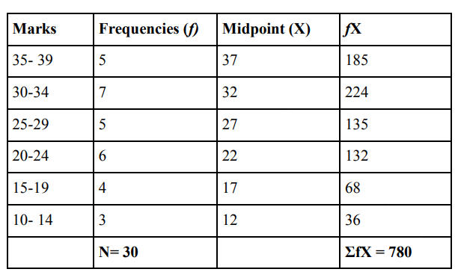
Let us now compute mean with the help of an example.
A class of 30 students were given a psychology test and the marks obtained by them were categorised in to six categories. The lowest marks obtained were 10 and highest marks obtained were 35. A class interval of 5 was employed.
The data is given as follows:

Slide 88
The steps followed for computation of mean with grouped data are as follows:
Step 1: The data is arranged in a tabular form with marks grouped in categories with class interval of 5.
Step 2: Once the categories are created, the marks are entered under frequency column based on which category they fall under.
Step 3: The midpoints of the categories are computed and entered under X.
Step 4: fX is obtained by multiplying the frequencies and midpoints for each category.
Step 5: fX for all the categories are added to obtain ΣfX, in case of our example it is obtained as 780
Step 6: The formula M = ΣfX/ N is used, N is equal to 30.
M = ΣfX/ N
M = 780/ 30= 26
Thus, the mean obtained is 26

Slide 89
Computation of Median for Ungrouped Data
Odd Data:
Data: 58 34 32 47 74 67 35 34 30 (N= 9)
Step 1: First the data is to be arranged in either ascending or descending order. We will arrange the data in ascending order and it will look like this:
30 32 34 34 35 47 58 67 74
Step 2: The following formula is then used to compute Median: M_{d} = (N +1)/2
Thus (9 +1)/2= 10/2 =5 th item
In our data the 5th item is 35, that is the median of this data.

Slide 90
Even data:
58 34 32 47 74 67 35 34 30 39 (N= 10)
Step 1: First the data is to be arranged in either ascending or descending order. We will arrange the data in ascending order and it will look like this:
30 32 34 34 35 39 47 58 67 74
Step 2: The following formula is used to compute median: M_{d} = (N/2)^{th} score + [(N/2)^{th} score + 1]/ 2
The (N/2)^{th} score is the 5 ^{th} score, that is 35.
The (N/2)^{th} score + 1 is the 6th score, that is 39.Thus 35 +39/ 2= 37
The median thus obtained is 37.

Slide 91
Computation of Median for Grouped Data
The formula used for computation of median for grouped data is as follows:
M_{d}=L+[(N/2)−F/f _{m} ]×i
Where,
L = The lower limit of the median class
N = Total of all the frequencies
F = Sum of frequencies before the median class
f _{m} = frequency within the interval upon which the median falls
i = class interval.

Slide 92
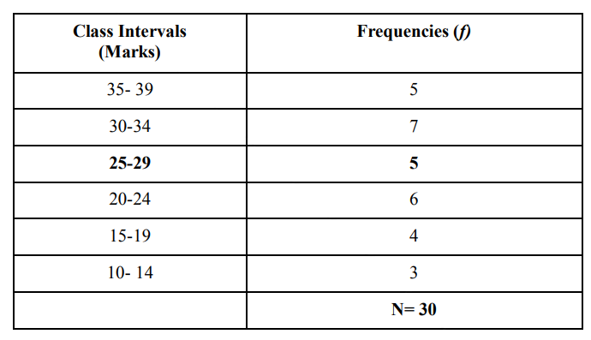

Slide 93
The steps in computing median for grouped data are as follows:
Step 1: The first step is to compute N/2, that is 30/2 so that we obtain one half of the scores in the data (15 in this case).
Step 2: As the scores are even in number (N= 30), the median should fall between 15th and 16th score. Whether we add the frequencies from above (5+7+5= 17) or from below (3+4+6+5= 18), the median will fall in the class interval 25-29. Further L that is the lower limit of the median class can also be mentioned. As the median class is 25-29, its lower limit will be 24.5.
Step 3: Compute F, that is sum of frequencies before the median class. In our example it would be 3 +4 +6 = 13
Step 4: f _{m} is computed. It is the frequency within the interval upon which the median falls. In the present example the median class interval is 25- 29 and the frequency for this class interval is 5. So f _{m} is 5.

Slide 94
Step 5: The values can now be put in the formula to obtain the median M_{d}=L+[(N/2)−F/f_{m}] x i
= 24.5 +[(30/2)- 13/ 5] x 5
= 24.5 + [15- 13/5] x 5
= 24.5 + [2/ 5] x 5
= 24.5 + 10/ 5
= 24.5 +2
= 26. 5
Thus, the median obtained is 26. 5. And it falls in the median class interval 25-29.

Slide 95
Computation of Mode for Ungrouped Data
Let us now learn how to compute mode for an ungrouped data with the help of the following example:
58 34 32 47 74 67 35 34 30 39
The mode can be calculated in simple manner by just counting the scores that appears maximum number of times in the data.
In our example, the score occurring maximum number of times is 34, that occurs twice. Thus the mode is 34.

Slide 96
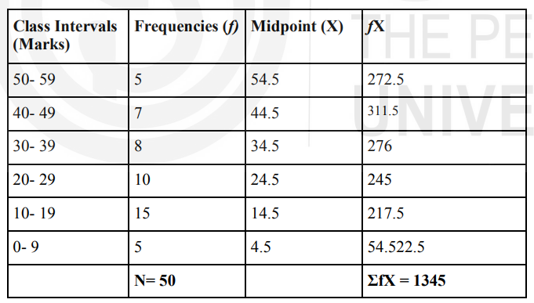
Computation of Mode for Grouped Data
First Method
The first method is by using the following formula Mode=3Mdn−2M
Where,
Mdn = Median
M= Mean

Slide 97
The formula M = ΣfX/ N is used, N is equal to 50.
Step 1: Compute mean M = ΣfX/ N, M = 1370/ 50= 26.9
Step 2: Compute median
M_{d}=L+[(N/2)−F/f_{m}] x i
= 19.5 +[(50/2)- 20/ 10] x 10
= 19.5 + [25- 20/10] x 10
= 19.5 + [5/ 10] x 10
= 19.5 + 5
= 24.5

Slide 98
Step 3: Let us now use these values in our formula and compute mode Mo=3Mdn−2M
M_{o}= 3 x 24.5 - 2 x 26.9
= 73.5 - 53.8
= 19.7
Thus the mode computed is 19.7
Also we can make one observation here that the mean obtained for our example is 26.9 the median is 24.5 and the mode is 19.7. All the three values are not close to each other indicating that the distribution of the data may not be normal as the values do not fall in the central area of the distribution. If the values of mean, median and mode were similar, then we could have said that the data is normally distributed.

Slide 99
Second Method
In the second method of computing mode for grouped data the following formula is used:
M_{o}= L + [d₁/ d₁ +d₂] x i
Where,
L= Lower limit of the class interval in which the mode may lie, called as modal class
i = Class interval
d₁ = difference between frequencies of modal class and class interval below it.
d₂ = difference between frequencies of modal class and class interval above it.

Slide 100
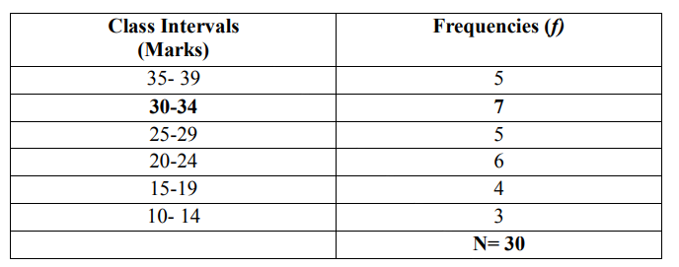

Slide 101
Step 1: The mode is most likely to fall in the the class intervals 30-34 as that has the highest frequencies (7). Thus this is our modal class and the lower limit of the same (L) will be 29.5.
Step 2: The class interval (i) for this example is 5.
Step 3: Compute d₁, that is, difference between frequencies of modal class and class interval below it and d₂, that is, difference between frequencies of modal class and class interval below it.
d₁ =f_{m} - f_{m-1}
d₂ = f_{m} - f_{m+1}
Where, fm = the frequency of the modal class (7 in case of our example).
fm-1 = the frequency of the class interval below the modal class (5 in case of our example). fm+1 = the frequency of the class interval above the modal class (5 in case of our example). Thus, d₁= 7-5 = 2 and d₂= 7-5 = 2 in case of our example.

Slide 102
Step 4: Now let us compute mode with the help of the formula
M_{o}= L + [d₁/ d₁ +d₂] x i
M_{o}= 29.5 +[2/2+2]x 5
= 29.5 +2/4 x 5
= 29.5 +10 /4
= 29.5 + 2.5
= 32
Thus, the mode obtained is 32.

Slide 103
Data presentation
Analysing, presenting and using data to make decisions is an essential function for professionals in a variety of industries.
The ability to organise and share data increases the impact of your research, spreads awareness and can motivate others to take desired actions.
Learning what data presentation is and how you can use it may help you improve your communication skills and make your research more effective.

Slide 104
Data Analysis and Data Presentation have a practical implementation in every possible field. It can range from academic studies, commercial, industrial and marketing activities to professional practices.
In its raw form, data can be extremely complicated to decipher and in order to extract meaningful insights from the data, data analysis is an important step towards breaking down data into understandable charts or graphs.

Slide 105
Data analysis tools used for analyzing the raw data which must be processed further to support N number of applications.
Therefore, the processes or analyzing data usually helps in the interpretation of raw data and extract the useful content out of it. The transformed raw data assists in obtaining useful information.
Once the required information is obtained from the data, the next step would be to present the data in a graphical presentation.
The presentation is the key to success. Once the information is obtained the user transforms the data into a pictorial Presentation so as to be able to acquire a better response and outcome.

Slide 106
Good data presentation helps…
Make informed decisions and arrive at positive outcomes. If you see the sales of your product steadily increase throughout the years, it’s best to keep milking it or start turning it into a bunch of spin-offs (shoutout to Star Wars).
Reduce the time spent processing data. Humans can digest information graphically 60,000 times faster than in the form of text. Grant them the power of skimming through a decade of data in minutes with some extra spicy graphs and charts.
Communicate the results clearly. Data does not lie. They’re based on factual evidence and therefore if anyone keeps whining that you might be wrong, slap them with some hard data to keep their mouths shut.
Add to or expand the current research. You can see what areas need improvement, as well as what details often go unnoticed while surfing through those little lines, dots or icons that appear on the data board

Slide 107
Data can be presented in a variety of formats, including:
Tables: Tables are a simple and effective way to present data. They allow for precise values to be displayed and are especially useful when the audience needs to know exact figures.
Graphs and Charts: Graphs and charts are often used when it’s helpful to visualize trends, comparisons, or relationships in the data. This includes bar graphs, line graphs, pie charts, scatter plots, and more.
Maps: For data with a geographical component, maps can be an effective way to present data. Heat maps, choropleth maps, and geographic information system (GIS) maps are all common types of data maps.
Infographics: Infographics combine graphics and text to present data in a visually engaging way. They are often used to present a narrative or to illustrate complex concepts or relationships.
Dashboards: Dashboards present key data points or metrics in a way that can be quickly understood. They are often interactive, allowing the user to drill down into the data or view different aspects of the data.
Reports: Written reports often include a combination of text, tables, and figures to present data. They typically provide a more detailed and comprehensive presentation of the data than other formats.

Slide 108
Types Of Data Presentation

Slide 109
Textual
When presenting data in this way, you use words to describe the relationship between information.
Textual presentation enables researchers to share information that cannot display on a graph. An example of data you may present textually is findings in a study.
When a researcher wants to provide additional context or explanation in their presentation, they may choose this format because, in text, information may appear more clear.
Textual presentation is common for sharing research and presenting new ideas. It only includes paragraphs and words, rather than tables or graphs to show data.
When presenting data as text, all you do is write your findings down in paragraphs and bullet points, and that’s it.

Slide 110
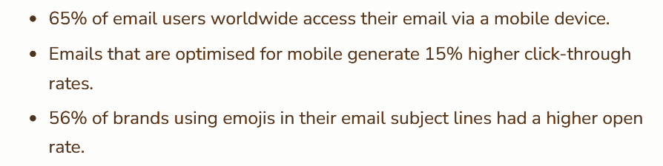

Slide 111
Tabular
Tabular presentation is using a table to share large amounts of information. When using this method, you organise data in rows and columns according to the characteristics of the data.
Tabular presentation is useful in comparing data, and it helps visualise information.
The benefits of using a table to share your data are that it simplifies the data making it easily consumable to viewers, helps provide a side-by-side comparison of the variables you choose and it can save space in your presentation because a table condenses the information.

Slide 112
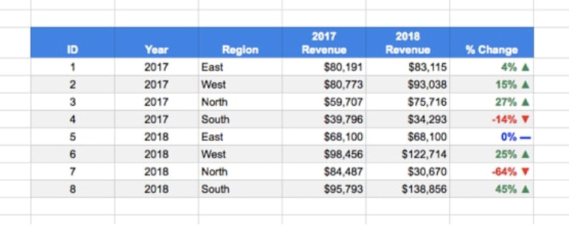
Among various types of data presentation, tabular is the most fundamental method, with data presented in rows and columns. Excel or Google Sheets would qualify for the job. Nothing fancy.

Slide 113
Researches use this type of presentation in analysis, such as:
Qualitative classification: Qualities including, nationality, age, social status, appearance, and personality traits may appear in a table to review and compare sociological and psychological information.
Quantitative classification: This category includes items you can count or number.
Spatial classification: This applies to situations where information uses a basis of location, such as data on a city, state or region.
Temporal classification: Time is the variable in this category, so any measure of time, including, seconds, hours, days or weeks, may help classify the data.

Slide 114
Diagrammatic
This method of displaying data uses diagrams and images. It is the most visual type for presenting data and provides a quick glance at statistical data.
There are four basic types of diagrams, including:
Pictograms: This diagram uses images to represent data. For example, to show the number of books sold in the first release week, you may draw five books, where each image accounts for 1,000 books and consumers bought 5,000 books.
Cartograms: This includes any type of map that shares the location of a person, place or object. For example, cartograms help navigate theme parks so you can find attractions, food and gift shops.
Bar graphs: This type uses rectangles of different sizes on an x and y-axis to represent different amounts in a data set. It depicts numerical values and uses rectangles to display data for variables in your research.
Pie charts: In this type of diagram, data appears as a fraction in a circle. This displays any type of numerical data but works well with fewer variables.

Slide 115
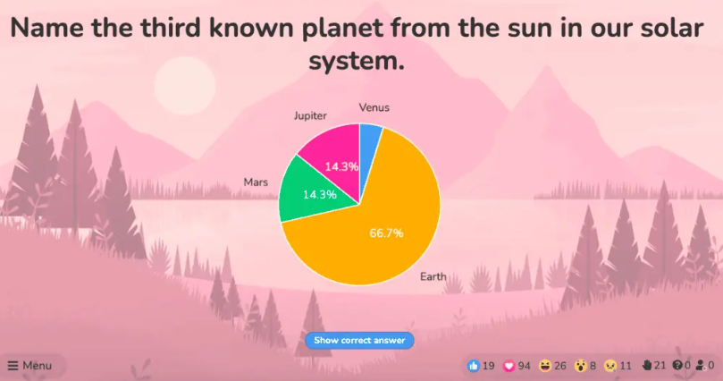
Pie chart
A pie chart (or a ‘donut chart’ if you stick a hole in the middle of it) is a circle divided into slices that show the relative sizes of data within a whole.
If you’re using it to show percentages, make sure all the slices add up to 100%.
The pie chart is a familiar face at every party and is usually recognised by most people.
However, one setback of using this method is our eyes sometimes can’t identify the differences in slices of a circle, and it’s nearly impossible to compare similar slices from two different pie charts, making them the villains in the eyes of data analysts.

Slide 116
Bar chart
The bar chart is a chart that presents a bunch of items from the same category, usually in the form of rectangular bars that are placed at an equal distance from each other. Their heights or lengths depict the values they represent.
Or more complex and detailed like this example of presentation of data.
Contributing to an effective statistic presentation, this one is a grouped bar chart that not only allows you to compare categories but also the groups within them as well.

Slide 117
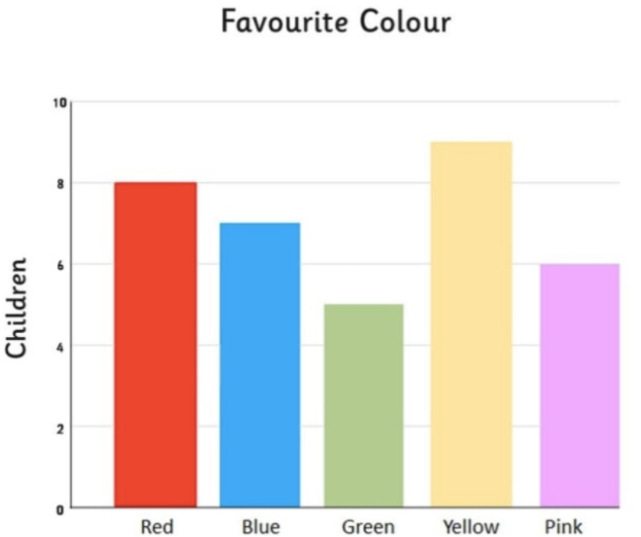
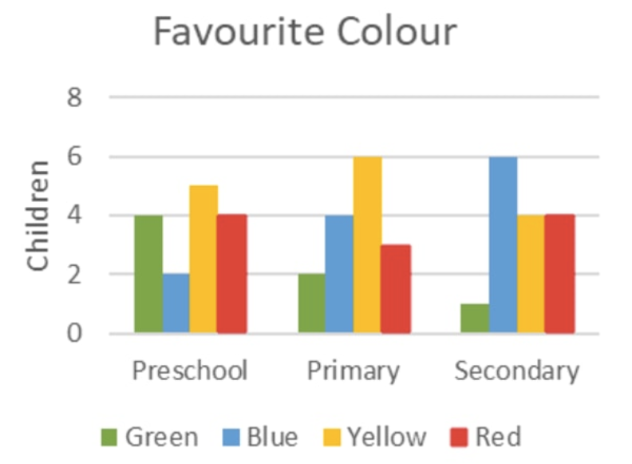

Slide 118
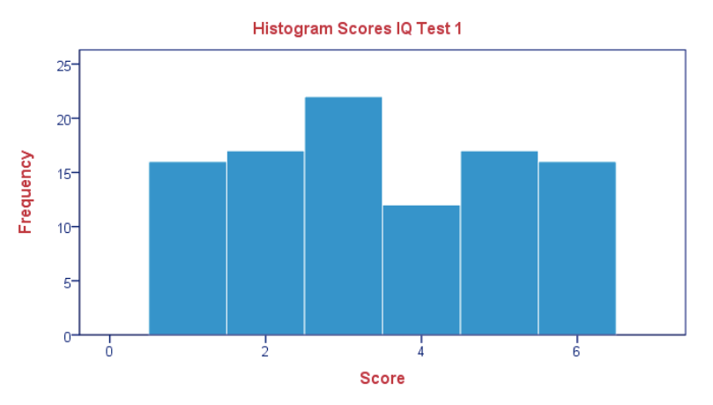
Histogram
Similar in appearance to the bar chart but the rectangular bars in histograms don’t often have the gap like their counterparts.
Instead of measuring categories like weather preferences or favourite films as a bar chart does, a histogram only measures things that can be put into numbers.

Slide 119
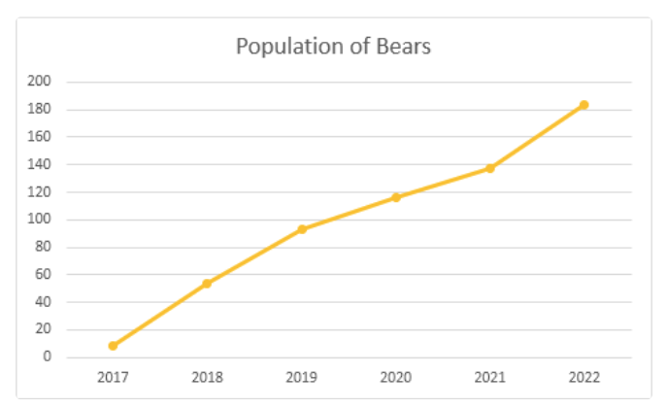
Line graph
Recordings to ways of displaying data, we shouldn’t overlook the effectiveness of line graphs.
Line graphs are represented by a group of data points joined together by a straight line. There can be one or more lines to compare how several related things change over time.
On a line chart horizontal axis, you usually have text labels, dates or years, while the vertical axis usually represents the quantity (e.g.: budget, temperature or percentage).

Slide 120
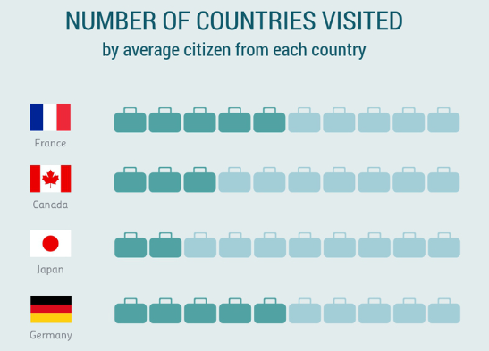
Pictogram graph
A pictogram graph uses pictures or icons relating to the main topic to visualise a small dataset. The fun combination of colours and illustrations makes it a frequent use at schools.
Pictograms are a breath of fresh air if you want to stay away from the monotonous line chart or bar chart for a while. However, they can present a very limited amount of data and sometimes they are only there for displays and do not represent real statistics.

Slide 121
Radar chart
If presenting five or more variables in the form of a bar chart is too stuffy then you should try using a radar chart, which is one of the most creative ways to present data.
Radar charts show data in terms of how they compare to each other starting from the same point. Some also call them ‘spider charts’ because each aspect combined looks like a spider web.

Slide 122
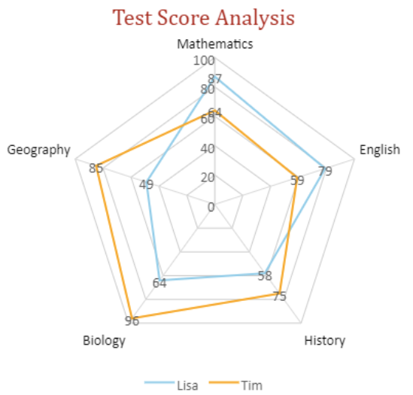
Radar charts can be a great use for parents who’d like to compare their child’s grades with their peers to lower their self-esteem. You can see that each angular represents a subject with a score value ranging from 0 to 100. Each student’s score across 5 subjects is highlighted in a different colour.

Slide 123
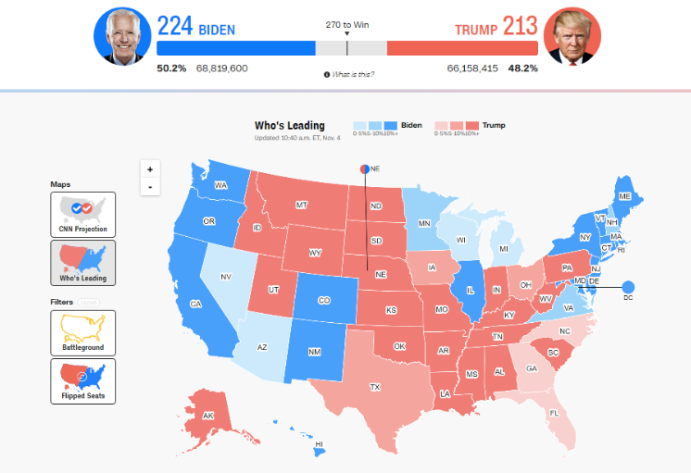
Heat map
A heat map represents data density in colours. The bigger the number, the more colour intense that data will be represented.
For elections, many news outlets assign a specific colour code to a state, with blue representing one candidate and red representing the other. The shade of either blue or red in each state shows the strength of the overall vote in that state.

Slide 124
Scatter plot
If you present your data in dots instead of chunky bars, you’ll have a scatter plot.
A scatter plot is a grid with several inputs showing the relationship between two variables. It’s good at collecting seemingly random data and revealing some telling trends.

Slide 125
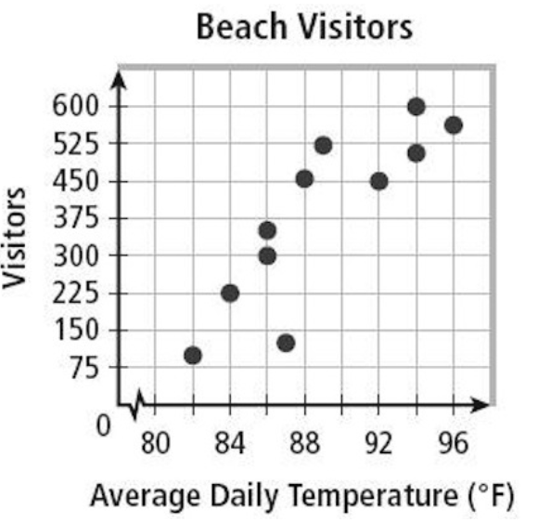
For example, in this graph, each dot shows the average daily temperature versus the number of beach visitors across several days. You can see that the dots get higher as the temperature increases, so it’s likely that hotter weather leads to more visitors.

Slide 126
How To Present Data?
1. Organise your data
2. Identify your audience
3. Choose a presentation type
4. Label your data
5. Introduce your research
6. Focus on main data points
7. Summarise

Slide 127
1. Organise your data
Once your research is complete, analyse and categorise your data. This can include making conclusions and recognising the relationships between data points. You might organise your data by qualities, quantities, time or space.
Putting the data you collect into categories based on its most identifiable features is useful in helping you determine how to best present the data.
Organisation also helps compare the data and make important conclusions or to answer your research questions.
For example, if your research is to determine which day of the week is most productive and you survey a group of professionals, then you may learn not only which day people are most productive but also may draw conclusions about productivity among different careers and age groups.

Slide 128
2. Identify your audience
Knowing who your audience is can help you choose how to present your data. Consider how knowledgeable the audience is on your data topic.
For example, if you are presenting data on the performance of a product to your team, they need less context than a group of investors, who may require background information on the product.
Other important information to know about your audience includes their interests, problems they experience and how you can resolve these issues, their motivation for attending your presentation and their general life experience.
Understanding your audience helps customise the presentation to them and increases its effectiveness.
You might also consider the reaction you desire from your audience when they view your data.
For example, if you want to convince them to support a cause, ensure your data reflects this purpose.
You can learn more about your audience by sending them surveys ahead of your presentation with questions about their understanding of your data topic and their motivations for learning more.

Slide 129
3. Choose a presentation type
Review the types of data presentation to determine if you are required to use textual, tabular or diagrammatic presentation.
If you choose a diagrammatic presentation you can also identify which type of diagram fits your data best. To determine which format is most appropriate, identify what you are comparing with your data.
For example, if you are comparing values of a small number of variables, a pie chart accurately shows percentages and can reveal volumes. A bar graph can show a more precise comparison of values. If you are presenting information where characteristics or time is a variable, you might choose a table. You may use textual presentation when you want to provide more context for your data and explain your findings.

Slide 130
4. Label your data
When creating a diagram or table, ensure that it has labels to describe the information.
Include a title that describes what the table or diagram shows and create labels for the variables that appear.
Some types, such as a pictogram or cartogram may require a key to share the scale you use when representing the data.
For example, images on a pictogram often represent a certain number.
These labels provide clarity to viewers and can help you when presenting the data by helping you to focus on the main points.

Slide 131
5. Introduce your research
After creating a visual or text to share your data, create an introduction that informs an audience about your data topic.
Include how and why you gather this data to provide context. You might share your research questions to preface what the data reveals.
Consider the key takeaways from your data and be sure to introduce these ideas to your audience through a slide presentation or speech.

Slide 132
6. Focus on main data points
You can determine the main data points by identifying how the data relate to each other.
For example, if you take a sample of how much time it takes different team members to complete a task, it is important to know intervals of time and which team member is the quickest and who is the slowest at completing the task.
In this example, you may also examine factors that contribute to how long it takes to complete a task.
Identifying the main ideas of your data and research helps organise your presentation and communicate clearly with your audience about the significance of the information you gather.

Slide 133
7. Summarise
At the end of your presentation, summarise your data findings to ensure that your audience understands. You can also give time for the audience to ask questions.
Try to prepare answers by thoroughly understanding your research and collection of data.
Consider questions about the impact the data has and actions the audience may take after seeing your presentation.

Slide 134
Importance of Data Presentation
Data Presentation could be both can be a deal maker or deal breaker based on the delivery of the content in the context of visual depiction.
Data Presentation tools are powerful communication tools that can simplify the data by making it easily understandable & readable at the same time while attracting & keeping the interest of its readers and effectively showcase large amounts of complex data in a simplified manner.
If the user can create an insightful presentation of the data in hand with the same sets of facts and figures, then the results promise to be impressive.
There have been situations where the user has had a great amount of data and vision for expansion but the presentation drowned his/her vision.
To impress the higher management and top brass of a firm, effective presentation of data is needed.
Data Presentation helps the clients or the audience to not spend time grasping the concept and the future alternatives of the business and to convince them to invest in the company & turn it profitable both for the investors & the company.

Slide 135
Although data presentation has a lot to offer, the following are some of the major reason behind the essence of an effective presentation:-
Many consumers or higher authorities are interested in the interpretation of data, not the raw data itself. Therefore, after the analysis of the data, users should represent the data with a visual aspect for better understanding and knowledge.
The user should not overwhelm the audience with a number of slides of the presentation and inject an ample amount of texts as pictures that will speak for themselves.
Data presentation often happens in a nutshell with each department showcasing their achievements towards company growth through a graph or a histogram.
Providing a brief description would help the user to attain attention in a small amount of time while informing the audience about the context of the presentation
The inclusion of pictures, charts, graphs and tables in the presentation help for better understanding the potential outcomes.
An effective presentation would allow the organization to determine the difference with the fellow organization and acknowledge its flaws. Comparison of data would assist them in decision making.

Slide 136
Data Presentation Mistakes to Avoid
#1 – Assume your audience understands what the numbers represent
#2 – Use the wrong type of chart
#3 – Make it 3D
#4 – Use different types of charts to compare contents in the same category
#5 – Bombard the audience with too much information

Slide 137
#1 – Assume your audience understands what the numbers represent
You may know all the behind-the-scenes of your data since you’ve worked with them for weeks, but your audience doesn’t.
Showing without telling only invites more and more questions from your audience, as they have to constantly make sense of your data, wasting the time of both sides as a result.
While showing your data presentations, you should tell them what the data are about before hitting them with waves of numbers first.
You can use interactive activities such as polls, word clouds and Q&A sections to assess their understanding of the data and address any confusion beforehand.

Slide 138
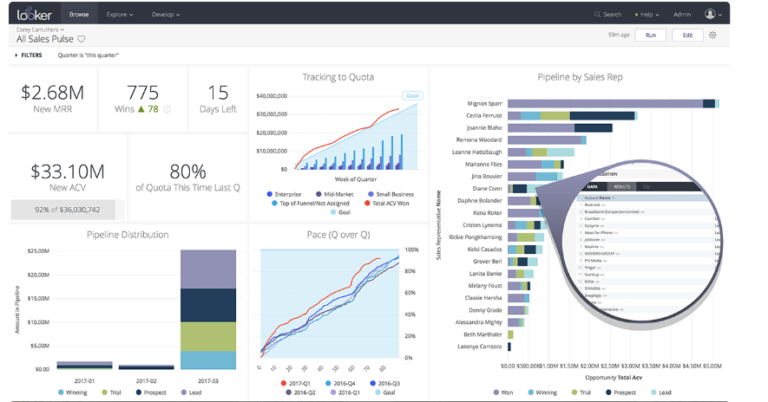

Slide 139
#2 – Use the wrong type of chart
Charts such as pie charts must have a total of 100% so if your numbers accumulate to 193% like this example below, you’re definitely doing it wrong.
Before making a chart, ask yourself: what do I want to accomplish with my data? Do you want to see the relationship between the data sets, show the up and down trends of your data, or see how segments of one thing make up a whole?
Remember, clarity always comes first. Some data visualisations may look cool, but if they don’t fit your data, steer clear of them.

Slide 140
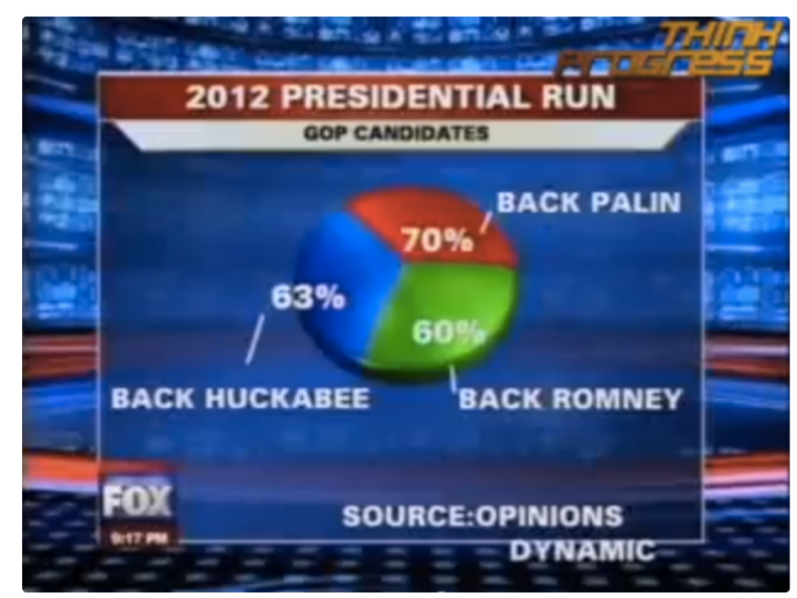

Slide 141
#3 – Make it 3D
3D is a fascinating graphical presentation example. The third dimension is cool, but full of risks.
Can you see what’s behind those red bars? Because we can’t either. You may think that 3D charts add more depth to the design, but they can create false perceptions as our eyes see 3D objects closer and bigger than they appear, not to mention they cannot be seen from multiple angles.

Slide 142
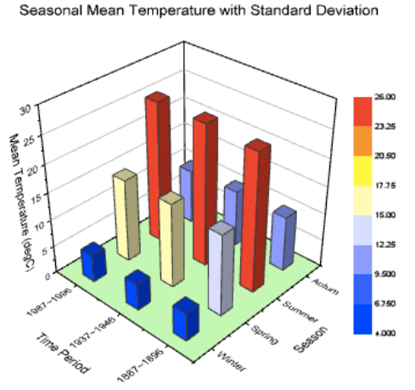

Slide 143
#4 – Use different types of charts to compare contents in the same category
This is like comparing a fish to a monkey. Your audience won’t be able to identify the differences and make an appropriate correlation between the two data sets.
Next time, stick to one type of data presentation only. Avoid the temptation of trying various data visualisation methods in one go and make your data as accessible as possible.

Slide 144
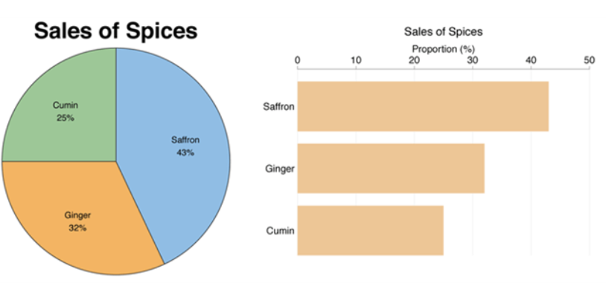

Slide 145
#5 – Bombard the audience with too much information
The goal of data presentation is to make complex topics much easier to understand, and if you’re bringing too much information to the table, you’re missing the point.
The more information you give, the more time it will take for your audience to process it all.
If you want to make your data understandable and give your audience a chance to remember it, keep the information within it to an absolute minimum.

Slide 146


Slide 147


Slide 148
Go for a scatter plot if you’re exploring the relationship between different data values, like seeing whether the sales of ice cream go up because of the temperature or because people are just getting more hungry and greedy each day?
Go for a line graph if you want to mark a trend over time.
Go for a heat map if you like some fancy visualisation of the changes in a geographical location, or to see your visitors’ behaviour on your website.
Go for a pie chart (especially in 3D) if you want to be shunned by others because it was never a good idea

